Slide 1
B-Trees
Data Structures & Program Design in C 2nd Ed
Robert Kruse / C.L. Tondo / Bruce Leung
BSc in Software Development
Computer Science 2
Notes:
BSc in Software Development - Year 3
Computer Science 2
B-Trees

Slide 2
External Searching:
Internal Information Retrieval:
  all our data structures are kept in high-speed memory.
External Information Retrieval:
  wish to locate and retrieve records stored in a disk file
BSc in Software Development
Computer Science 2

Slide 3
Access Time:
High speed memory:
  The required to access and retrieve a word is a few microseconds at most.
Disk:
  Locating a particular record on a disk is measured in milliseconds.
Floppy Disk:
  Access time could exceed a second.
Hence the time required for a single access is thousands of times greater for external retrieval than for internal retrieval.
BSc in Software Development
Computer Science 2
Notes:
BSc in Software Development - Year 3
Computer Science 2
B-Trees

Slide 4
Disk Access:
When a record is located on disk, the normal practice is not to read only one word, but to read in a large page or block of information at once.
Typical sizes for blocks range from 256 to 1024 characters or words.
BSc in Software Development
Computer Science 2

Slide 5
Goal in External Searching:
Minimize the number of disk accesses, since each access takes so long compared to internal computation.
With each access, we obtain a block that may have room for several records.
Using these records we may be able to make a multiway decision concerning which block to access next.
Therefore, multiway trees are especially appropriate for external searching.
BSc in Software Development
Computer Science 2

Slide 6
Multiway Search Trees:
Binary search trees generalise directly to multiway search trees.
Each node has at most m children, for some integer m called the order of the tree.
If k ≤ m is the number of children, then the node contains exactly k-1 keys, which partition all the keys in the subtrees into k subsets.
If some of these subsets are empty, then the corresponding children in the tree are empty.
Example: A 5-way search tree in which some of the children of some nodes are empty.
BSc in Software Development
Computer Science 2

Slide 7
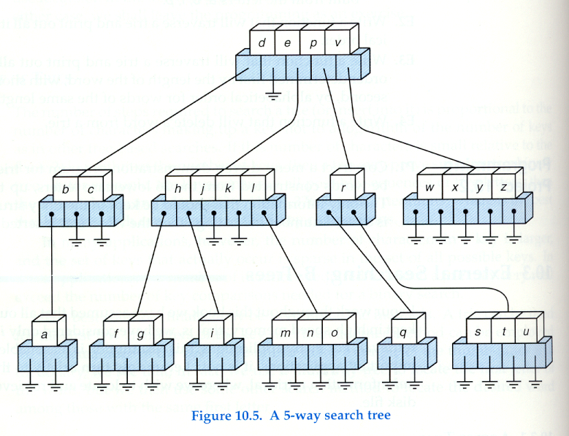
5-way Search Tree
BSc in Software Development
Computer Science 2

Slide 8
B-Trees (Balanced Multiway Trees):
Goal: a multiway search tree that will minimise file accesses.
Make the height of the tree as small as possible.
Therefore:
No empty subtrees should appear above the leaves, so that the division of keys into subsets is as efficient as possible.
All leaves should be on the same level, so that searches will be guaranteed to terminate with about the same number of accesses.
Every node (except the leaves) have at least some minimal number of children (half the maximum possible), so that the tree is as full as possible.
BSc in Software Development
Computer Science 2

Slide 9
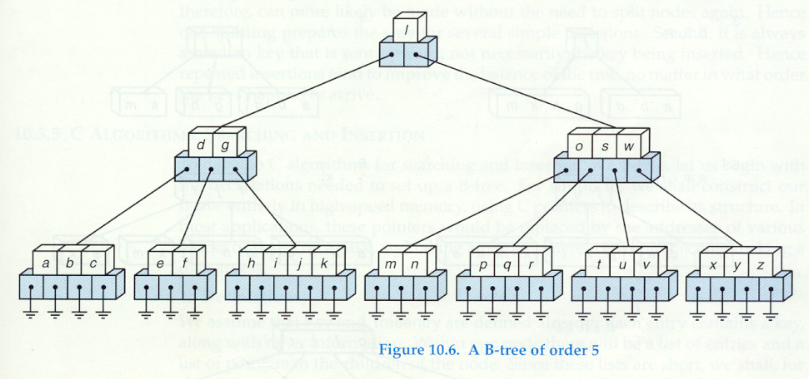
B-Tree of order 5
BSc in Software Development
Computer Science 2

Slide 10
Formal Definition of a B-Tree:
A B-Tree of order m is an m-way tree in which
All leaves are on the same level.
All internal nodes except the root have at most m nonempty children, and at least [m/2] nonempty children.
The number of keys in each internal node is one less than the number of its nonempty children, and these keys partition the keys in the children in the fashion of a search tree.
The root has at most m children, but may have as few as 2 if it is not a leaf, or none if the tree consists of the root alone.
BSc in Software Development
Computer Science 2

Slide 11
5-way Search Tree
B-Tree
BSc in Software Development
Computer Science 2

Slide 12
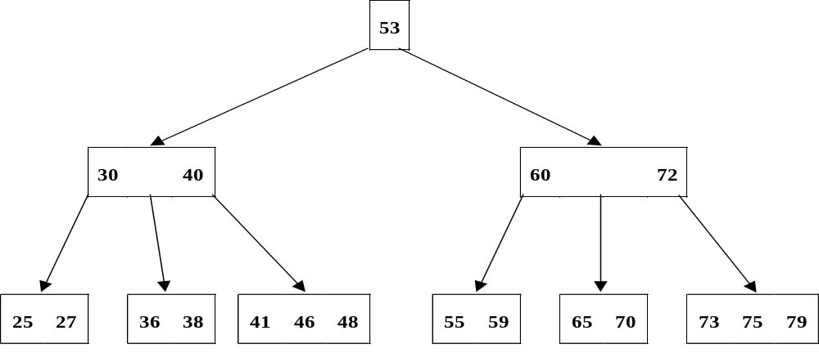
Searching a B-Tree
Example: A B-Tree of order 5 storing integer keys
To search this tree for the value 36, we begin at the root and compare 36 with the values stored in the root.
36 < 53 so continue searching along the branch that contains values less than 53 ( 0 branch)
BSc in Software Development
Computer Science 2

Slide 13
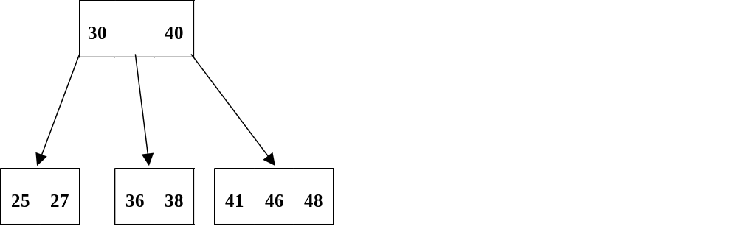

Comparing 36 with the values 30 and 40 stored in the root of this subtree, we find that 36 is between these values, therefore take branch 1 out of this node.
Examining the values in the root of this subtree, we locate the value 36
BSc in Software Development
Computer Science 2

Slide 14
Inserting into a B-Tree:
Begin with a single node and insert values into this node until it becomes full, i.e. 4 values in a B-tree of order 5.
When the next item is inserted, the node is split into two nodes, one storing the values less than the median and one storing the values greater then the median.
The median itself is stored in a parent having these two nodes as children.
BSc in Software Development
Computer Science 2

Slide 15

Example:
Insert 25, 40, 41, 27
These are arranged in ascending order and are stored in the root of a one node tree.
BSc in Software Development
Computer Science 2

Slide 16

Insert 55
Because the root is full, it must be split into two nodes, one containing 25 and 27, which are less than the median value, the other containing 41 and 55 which are greater than the median.
BSc in Software Development
Computer Science 2

Slide 17

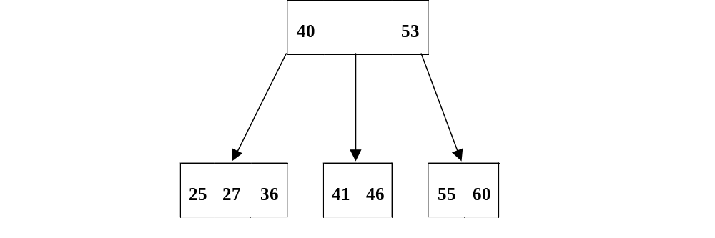
Now 36, 46, 60 can be inserted into the leaves.
If 53 is added, the rightmost leaf must be split
BSc in Software Development
Computer Science 2

Slide 18
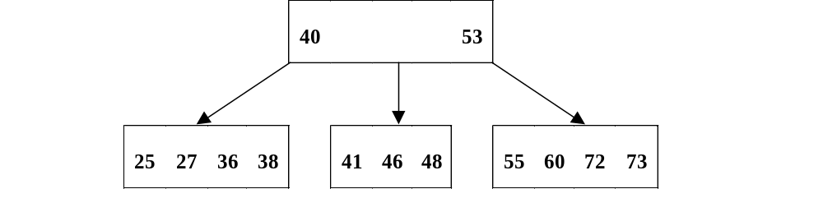
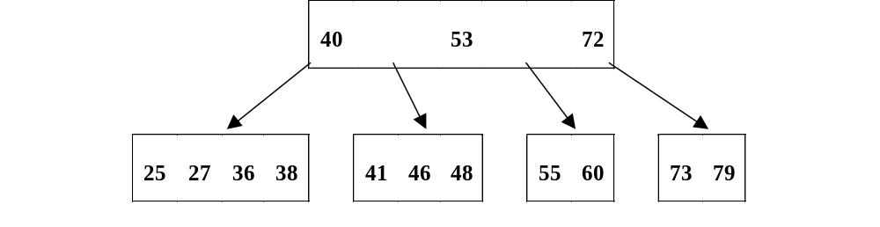
Now 38, 73, 48, 72 are inserted into the leaves.
No splitting is necessary.
The insertion of 79 forces a splitting of the rightmost leaf.
BSc in Software Development
Computer Science 2

Slide 19
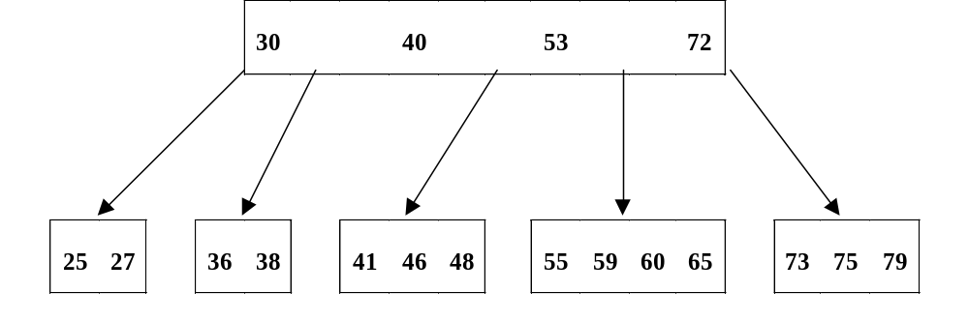
Now 59, 65 and 75 can be inserted into the leaves with no splitting.
The insertion of 30 causes the leftmost leaf to split.
BSc in Software Development
Computer Science 2

Slide 20
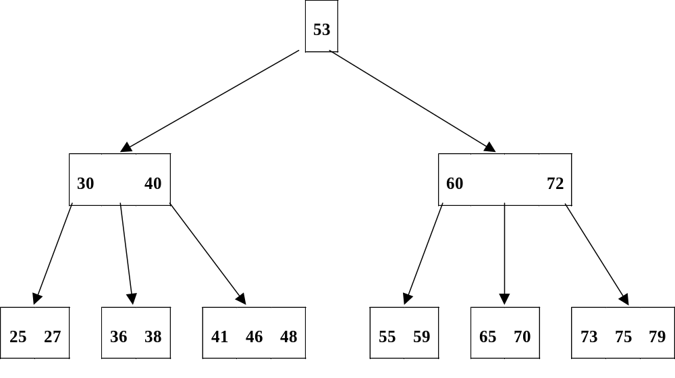
Finally, 70 is inserted into the fourth leaf, causing a split.
When the median 60 is inserted into the parent node, which is the root, it also must be split resulting in the following B-tree:
BSc in Software Development
Computer Science 2

Slide 21
Notes on Inserting into a B-Tree:
The tree built in this manner is balanced, having all of its leaf nodes at one level.
Each new item is placed in a leaf node if there is room.
If not, the leaf node splits into 2 and the MEDIAN value moves up to the parent node.
If there is no room there, it too splits into 2 with the (new) median value moving up.
So, in contrast to Binary Search Trees, B-Trees are not allowed to grow at their leaves, they are forced to grow at the root.
BSc in Software Development
Computer Science 2

Slide 22
Deletion from a B-Tree:
Simplest case:
  Delete a value in a leaf node. After deletion, the node still contains at least the minimum number of values.
Deletion of a value in an internal node
  Find its immediate predecessor (or successor). This must be in a leaf node.
  Copy this value up in place of the value to be deleted.
  Now delete the predecessor (successor) form the leaf node.
BSc in Software Development
Computer Science 2

Slide 23
Leaf Node contains too few values:
  Check to see if a neighbouring leaf node has a value to spare.
  If the neighbouring node to the left has a value to spare, do a move right.
  If the node that has the value to spare is on the right, move left.
  If neither neighbouring node has more than the minimal number, the leaf node must be combined with one of its neighbours and the value from the parent node to form a single leaf node.
  This is the opposite to splitting a leaf which occurs during insertion.
BSc in Software Development
Computer Science 2

Slide 24
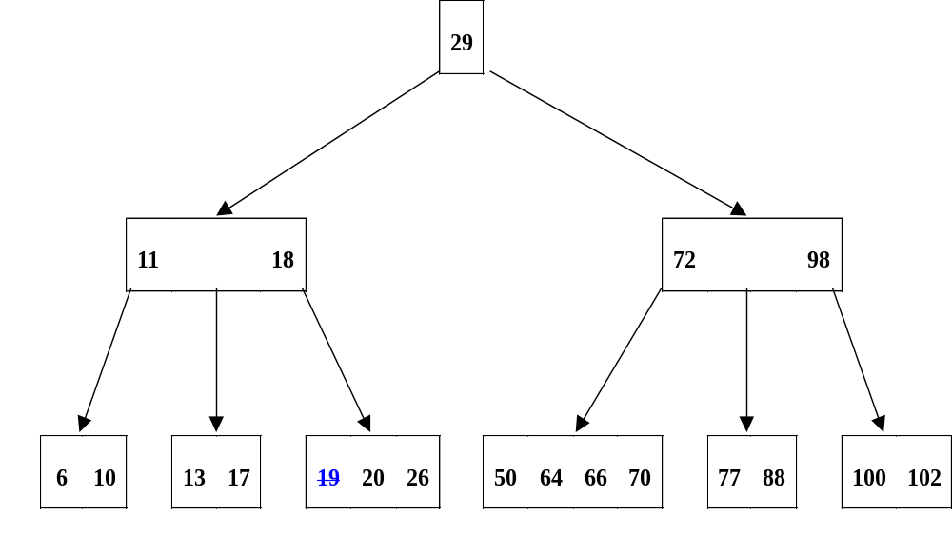
Example: Delete 19
Simplest case:
  Delete a value in a leaf node. After deletion, the node still contains at least the minimum number of values.
BSc in Software Development
Computer Science 2

Slide 25
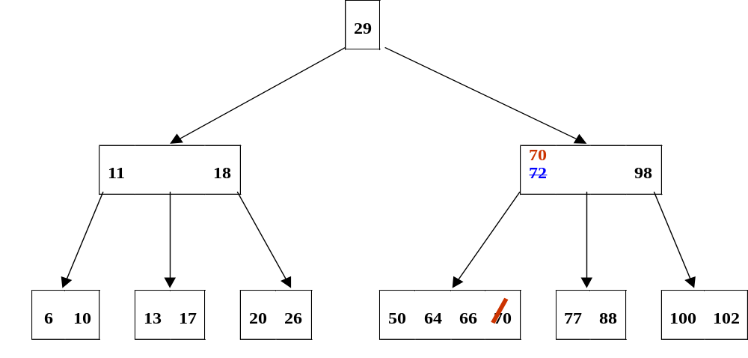
Delete 72:
Deletion of a value in an internal node
  Find its immediate predecessor (or successor). This must be in a leaf node.
  Copy this value up in place of the value to be deleted.
  Now delete the predecessor (successor) form the leaf node.
BSc in Software Development
Computer Science 2

Slide 26
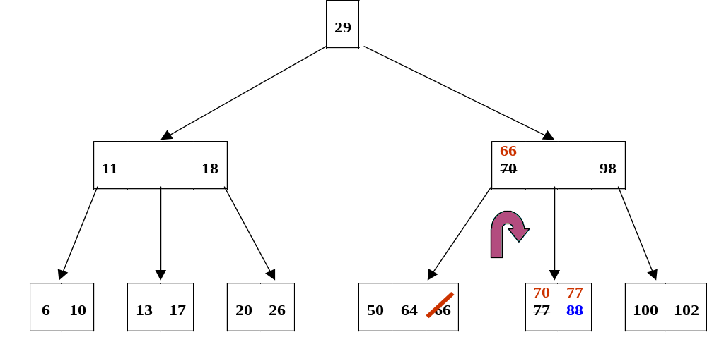
Delete 88:
Leaf Node contains too few values:
  Check to see if a neighbouring leaf node has a value to spare.
  If the neighbouring node to the left has a value to spare, do a move right.
BSc in Software Development
Computer Science 2

Slide 27
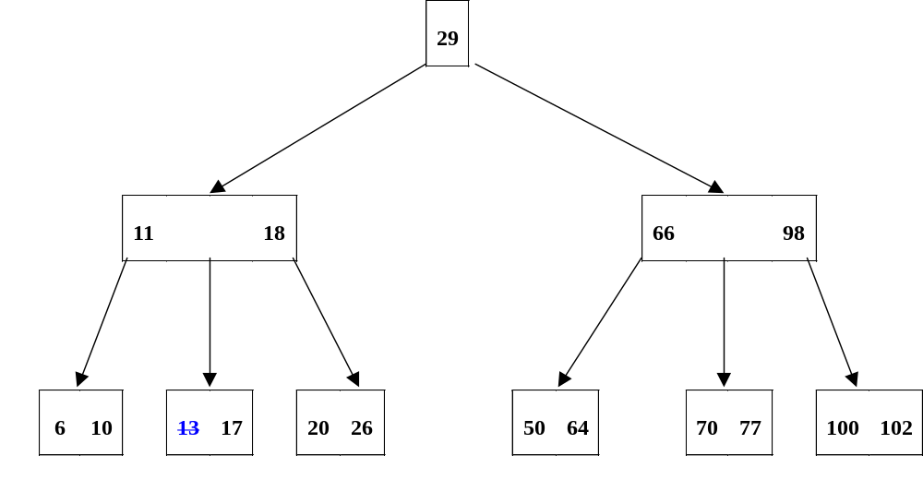
Delete 13:
Leaf Node contains too few values:
  If neither neighbouring node has more than the minimal number, the leaf node must be combined with one of its neighbours and the value from the parent node to form a single leaf node.
BSc in Software Development
Computer Science 2

Slide 28
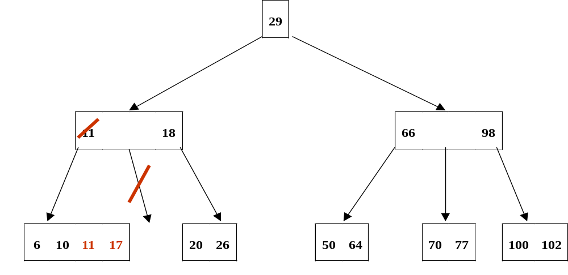
Combine the leaf node with the neighbour on the left and the value from its parent node to form a single leaf node.
BSc in Software Development
Computer Science 2

Slide 29
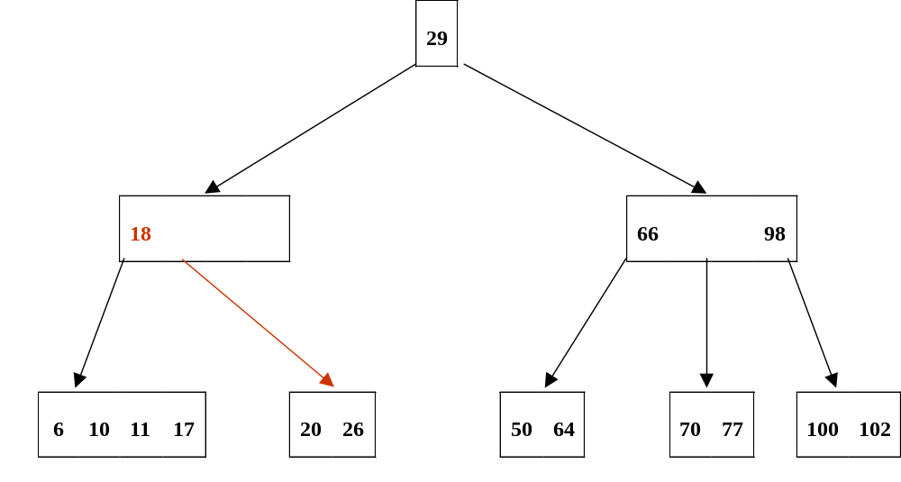
11 is then removed from the parent, which now has too few values.
This is corrected by combining higher level nodes in a similar fashion.
BSc in Software Development
Computer Science 2

Slide 30
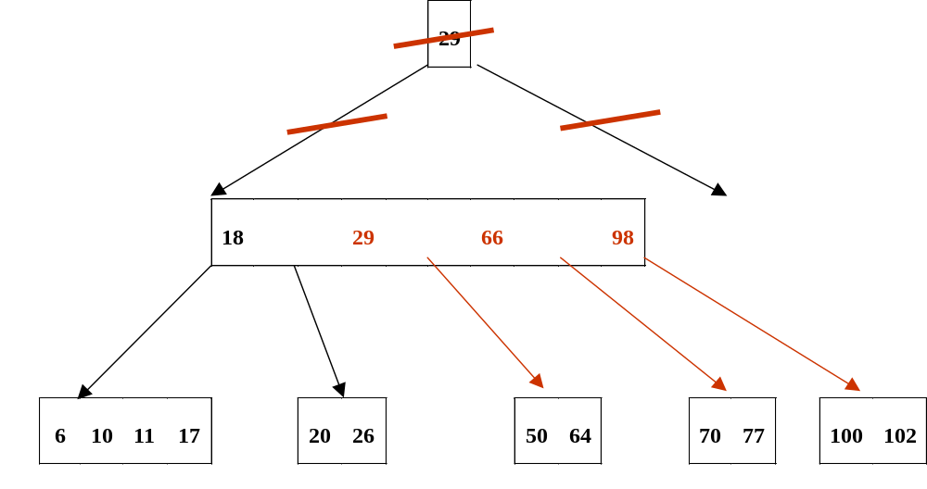
The parent node containing 18 needs another value and a neighbouring node on the same level doesn’t have a value to spare, so the neighbour on the right is combined with this node and the value from the parent to form a single node.
BSc in Software Development
Computer Science 2

Slide 31
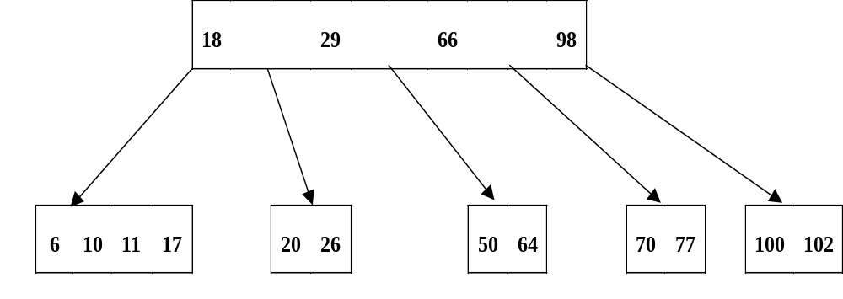
29 is removed from the root, so that the root is now empty, so this node is deleted and the node containing 18, 29, 66 and 98 becomes the new root of the tree.
BSc in Software Development
Computer Science 2

Slide 32
Notes on the operations on B-Trees:
Alterations may affect several levels of the tree.
The branch pointers let the functions move down the tree.
Moving back up the tree is a backtracking problem.
Recursion provides a way of solving this.
Recursive view of a B-Tree
  A B-Tree is either empty or it consists of a single node holding k-1 values and k pointers to B-Subtrees, for some k ≤m.
This view can be used to design recursive functions for the search, insert and delete routines.
BSc in Software Development
Computer Science 2

Slide 33
Application of B-Trees:
A B-Tree can be used as an index to a data file held on disc, providing direct access to the records through their key values.
As an alternative to the index sequential file, the B-Tree is a more complex structure requiring more complex processing, but does not suffer from the overflow problems.
When a large number of records with keys close together are added to the indexed sequential file, all the free space in the home block are used up and the records are placed into overflow blocks.
BSc in Software Development
Computer Science 2

Slide 34
Retrieval of these records will require a sequential search through the home and overflow blocks, with a deterioration in access time.
In the B-Tree, as records with keys close together are added, the leaf nodes split to provide more room for further additions.
When used as an index, each entry in the B-Tree is a key value and an associated pointer to the data record.
These entries (key + record pointer) play the role of the (integer values used in the examples discussed.
The branch pointers are held in the nodes as well and provide the links to the branch nodes in the index tree structure.
BSc in Software Development
Computer Science 2

Slide 35
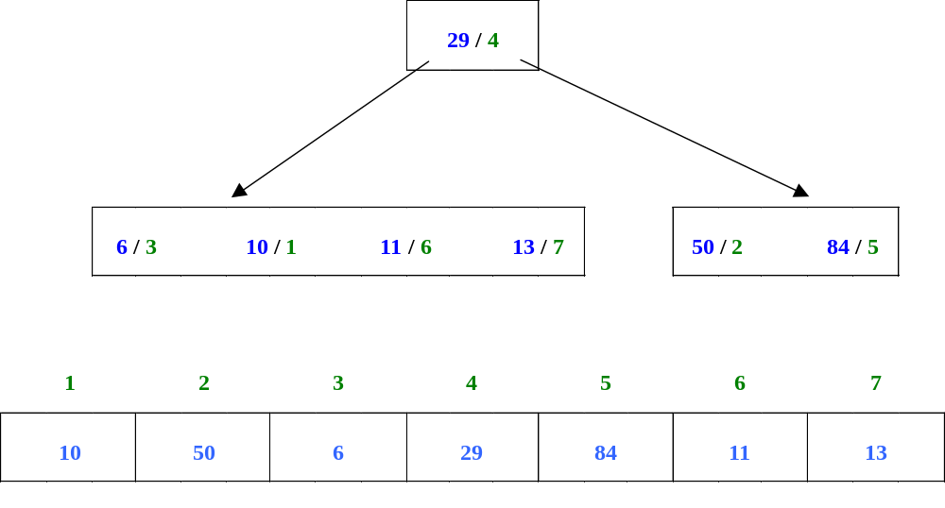
For example, the following illustrates this for a data file holding seven records with key values 10, 50, 6, 29, 84, 11 and 13, and a B-Tree of order 5.
The entries 29/4 etc. means key value 29 at data record 4.
BSc in Software Development
Computer Science 2

